Slide 1
Parking Lot Wars
Group members:
Jeff Gilbertson
Andy Artz
Elecio Coronado
Michele Jackson
Mia Fiocca

Slide 2
Genre
2D Arcade Racer

Slide 3
System Requirements
We plan on developing for iphone, android and other mobile devices.

Slide 4


Game Mechanics
In-game Items
Tools
Environment
Parking Lot
Hazards
Characters
Vehicles
Progression
Goals

Slide 5
Game Story
You are a loose cannon student who doesn’t play by the rules. Get to class on time no matter the cost.

Slide 6
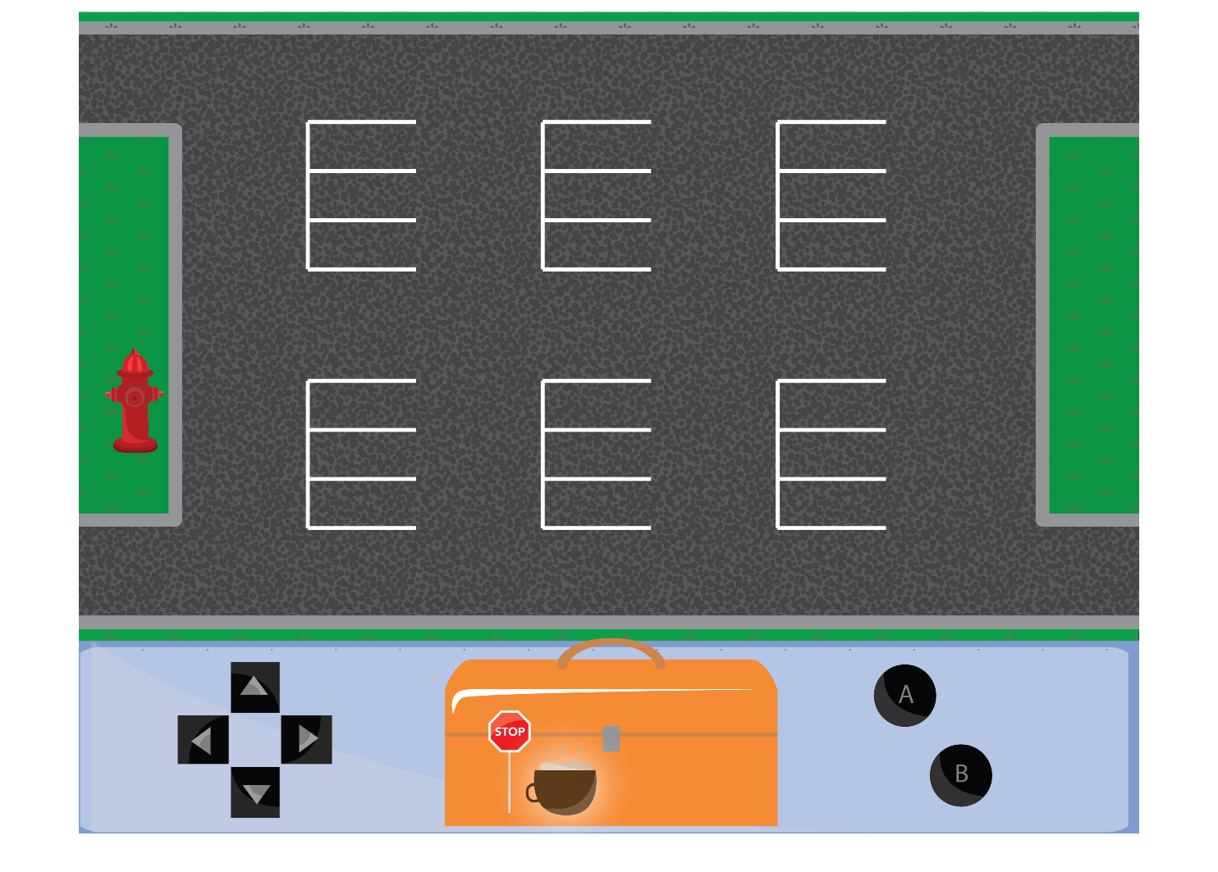
Game Controls & User Interface

Slide 7
Replayability
Level Editor
Sequel

Slide 8
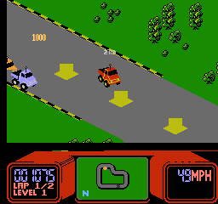
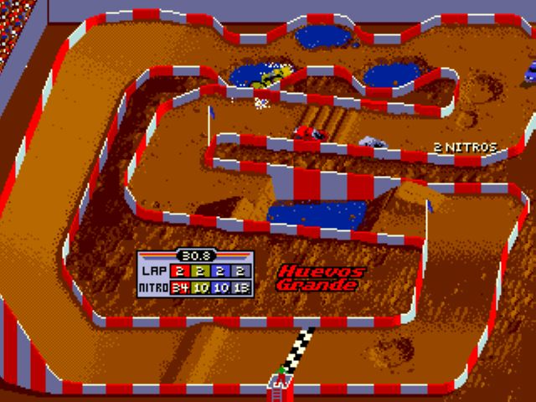
Inspirations and Examples
Super Off Road for the SNES
RC Pro-am for the NES

Slide 9


Art Assets

Slide 10


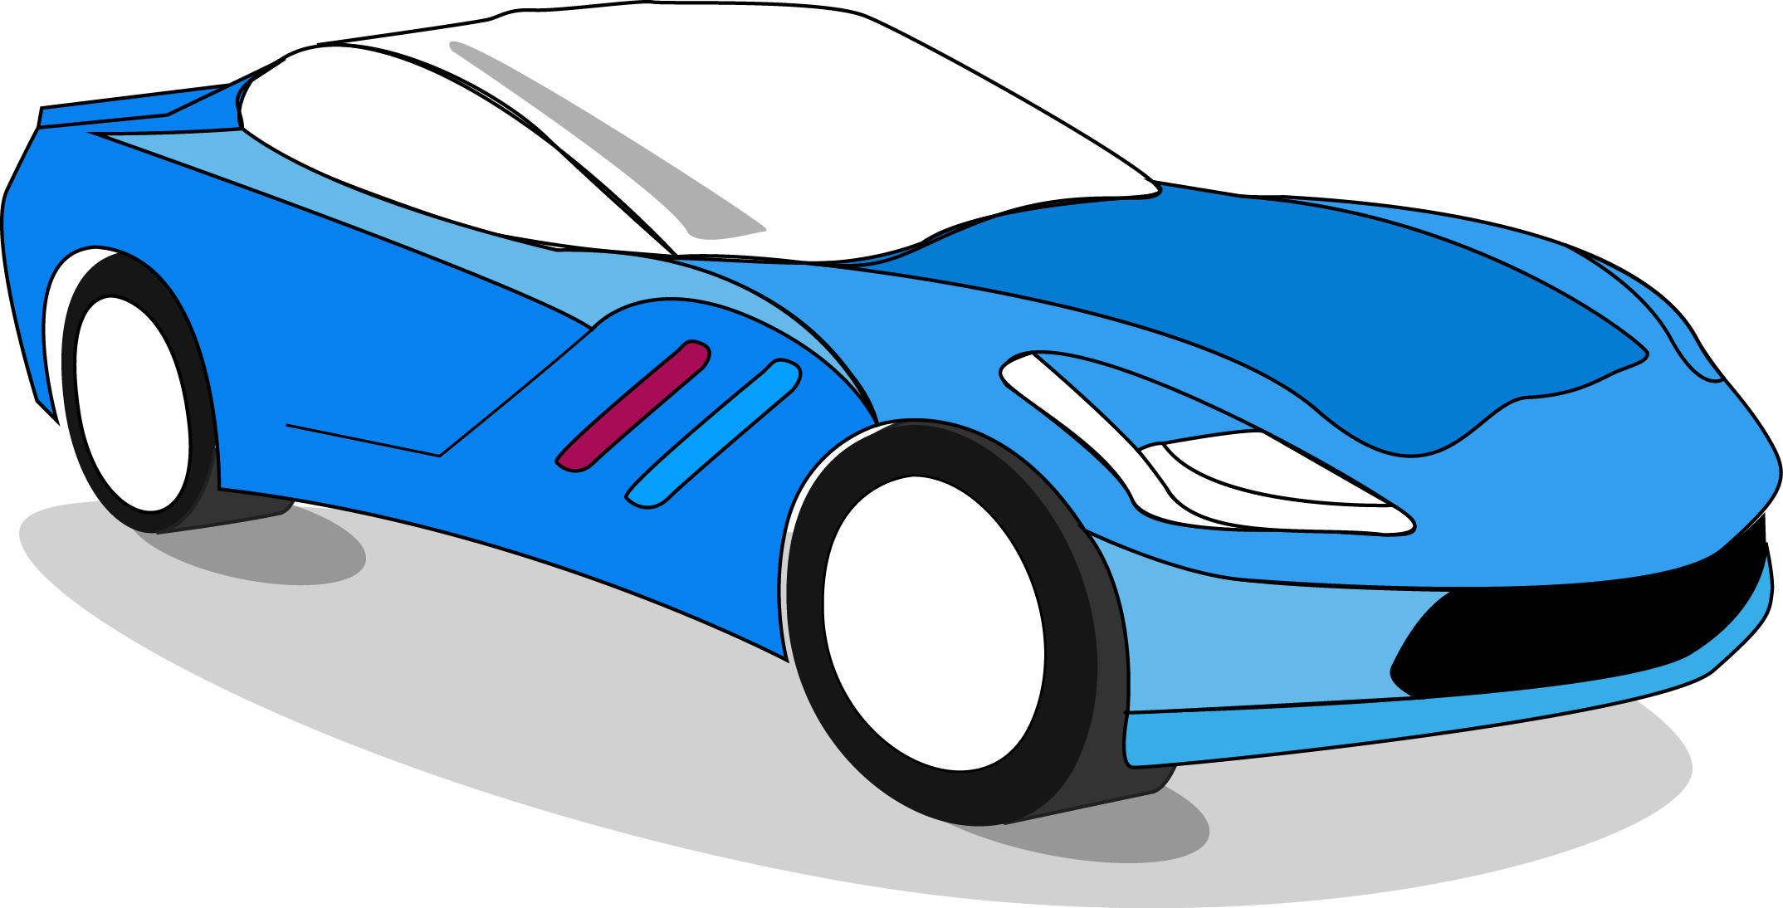
Art Assets

Slide 11




